Slide 1
Post-training Quantization (PTQ)

Slide 2
converter = tf.lite.TFLiteConverter.from_saved_model(CATS_VS_DOGS_SAVED_MODEL)
converter.optimizations = [tf.lite.Optimize.DEFAULT]
tflite_model = converter.convert()
tflite_model_file = 'converted_model.tflite'
with open(tflite_model_file, "wb") as f:
f.write(tflite_model)
Notes:
By setting the converter optimizations property here. In this case I set it to tf.lite.optimize.default. There are a few options for what you could do here, so let’s explore them.

Slide 3
converter = tf.lite.TFLiteConverter.from_saved_model(CATS_VS_DOGS_SAVED_MODEL)
converter.optimizations = [tf.lite.Optimize.DEFAULT]
tflite_model = converter.convert()
tflite_model_file = 'converted_model.tflite'
with open(tflite_model_file, "wb") as f:
f.write(tflite_model)
[tf.lite.Optimize.DEFAULT]
[tf.lite.Optimize.OPTIMIZE_FOR_SIZE]
[tf.lite.Optimize.OPTIMIZE_FOR_LATENCY]
Notes:
Optimize for size, as its name suggests, performs optimizations that make the model as small as possible

Slide 4
Quantization
Quantization is an optimization that works by reducing the precision of the numbers used to represent a model's parameters, which by default are 32-bit floating point numbers. This results in a smaller model size, better portability and faster computation.

Slide 5
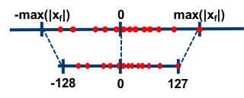
Reducing the Precision
float32
int8
max(|x_{f}|)
127
0
0
-128
min(|x_{f}|)
Notes:
Without a significant loss in accuracy -- so, for example the distribution on the right here, can end up having a very similar distribution when it’s recast into int8, but using ¼ of the memory

Slide 6
Why do we Quantize?

Slide 7
Quantization
Size
Latency
Portability

Slide 8
Quantization
Size
Latency
Portability

Slide 9
Size
Storage size: Smaller neural network models occupy less storage space on your device.
Notes:
https://pixabay.com/illustrations/hdd-harddrive-ssd-electronics-4861120/

Slide 10
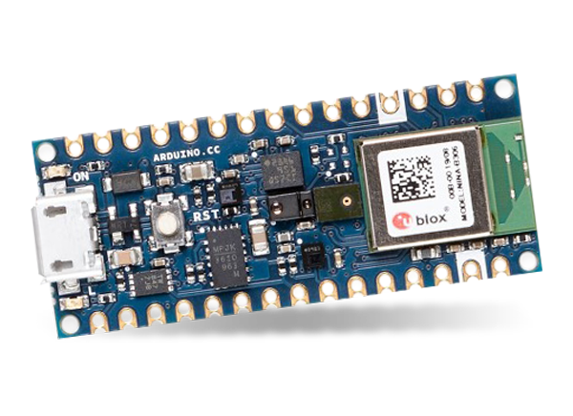
Storage & RAM Size
Our board (in your kit for Course 3) only has 256KB of RAM (memory) and 1MB of Flash (storage)
Storage size: Smaller neural network models occupy less storage space on your device, and in moving from 32-bits to 8-bits we readily get 4x reduction in memory.
Notes:
https://pixabay.com/illustrations/hdd-harddrive-ssd-electronics-4861120/

Slide 11
Storage & RAM Size
Less memory usage: Smaller models use less RAM when they are run, which frees up memory for other parts of your application to use, and can translate to better performance and stability.
Normal Stack
Model
Dynamic Variables
TFMicro Stack
Debugger
0 25 50 75 100 125 150 175
RAM Size [kB]

Slide 12
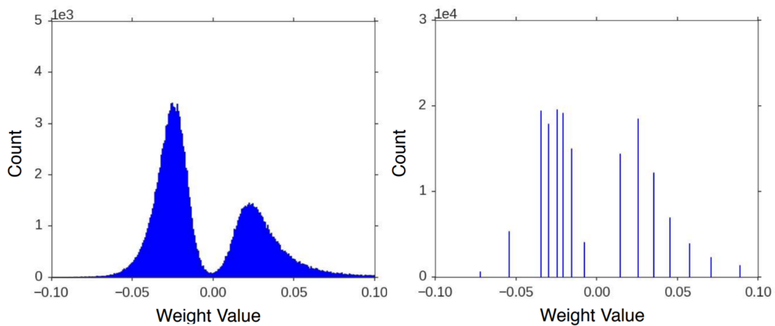
Weight Ranges
Weight distribution for AlexNet shows how most weight values are concentrated in a small range.
Source: “Deep Compression: Compressing Deep Neural Networks with Pruning, Trained Quantization and Huffman Coding” by Song Han, Huizi Mao, William J. Dally
Notes:
https://arxiv.org/pdf/1510.00149.pdf ← Fair use data/chart

Slide 13
Quantization
Size
Latency
Latency
Portability

Slide 14
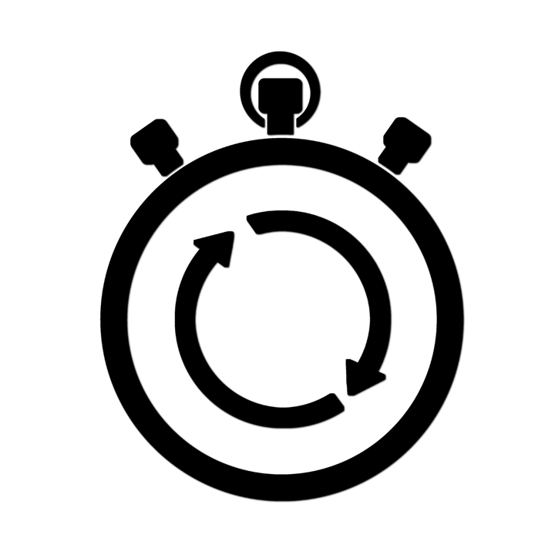
Latency
Int8 (v. fp32) format severely reduces the computation to run inference using a model, resulting in lower latency
Notes:
https://pixabay.com/vectors/stopwatch-time-icons-symbols-1749080/

Slide 15
Latency
Int8 (v. fp32) format severely reduces the computation to run inference using a model, resulting in lower latency
Latency optimizations can also have a notable impact on power consumption.
Notes:
https://pixabay.com/vectors/stopwatch-time-icons-symbols-1749080/

Slide 16
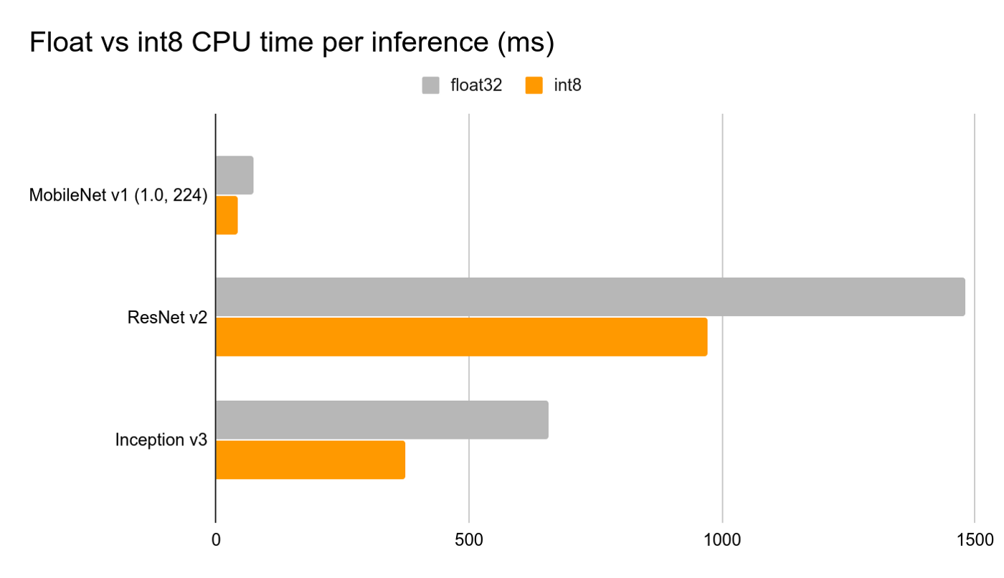
Int8 v. Float (CPU time per inference)
float32
MobileNet v1
int8
ResNet v2
Inception v3
0 500 1000 1500
Quantized models are up to 2–4x faster on CPU and 4x smaller.

Slide 17
Quantization
Size
Latency
Portability

Slide 18
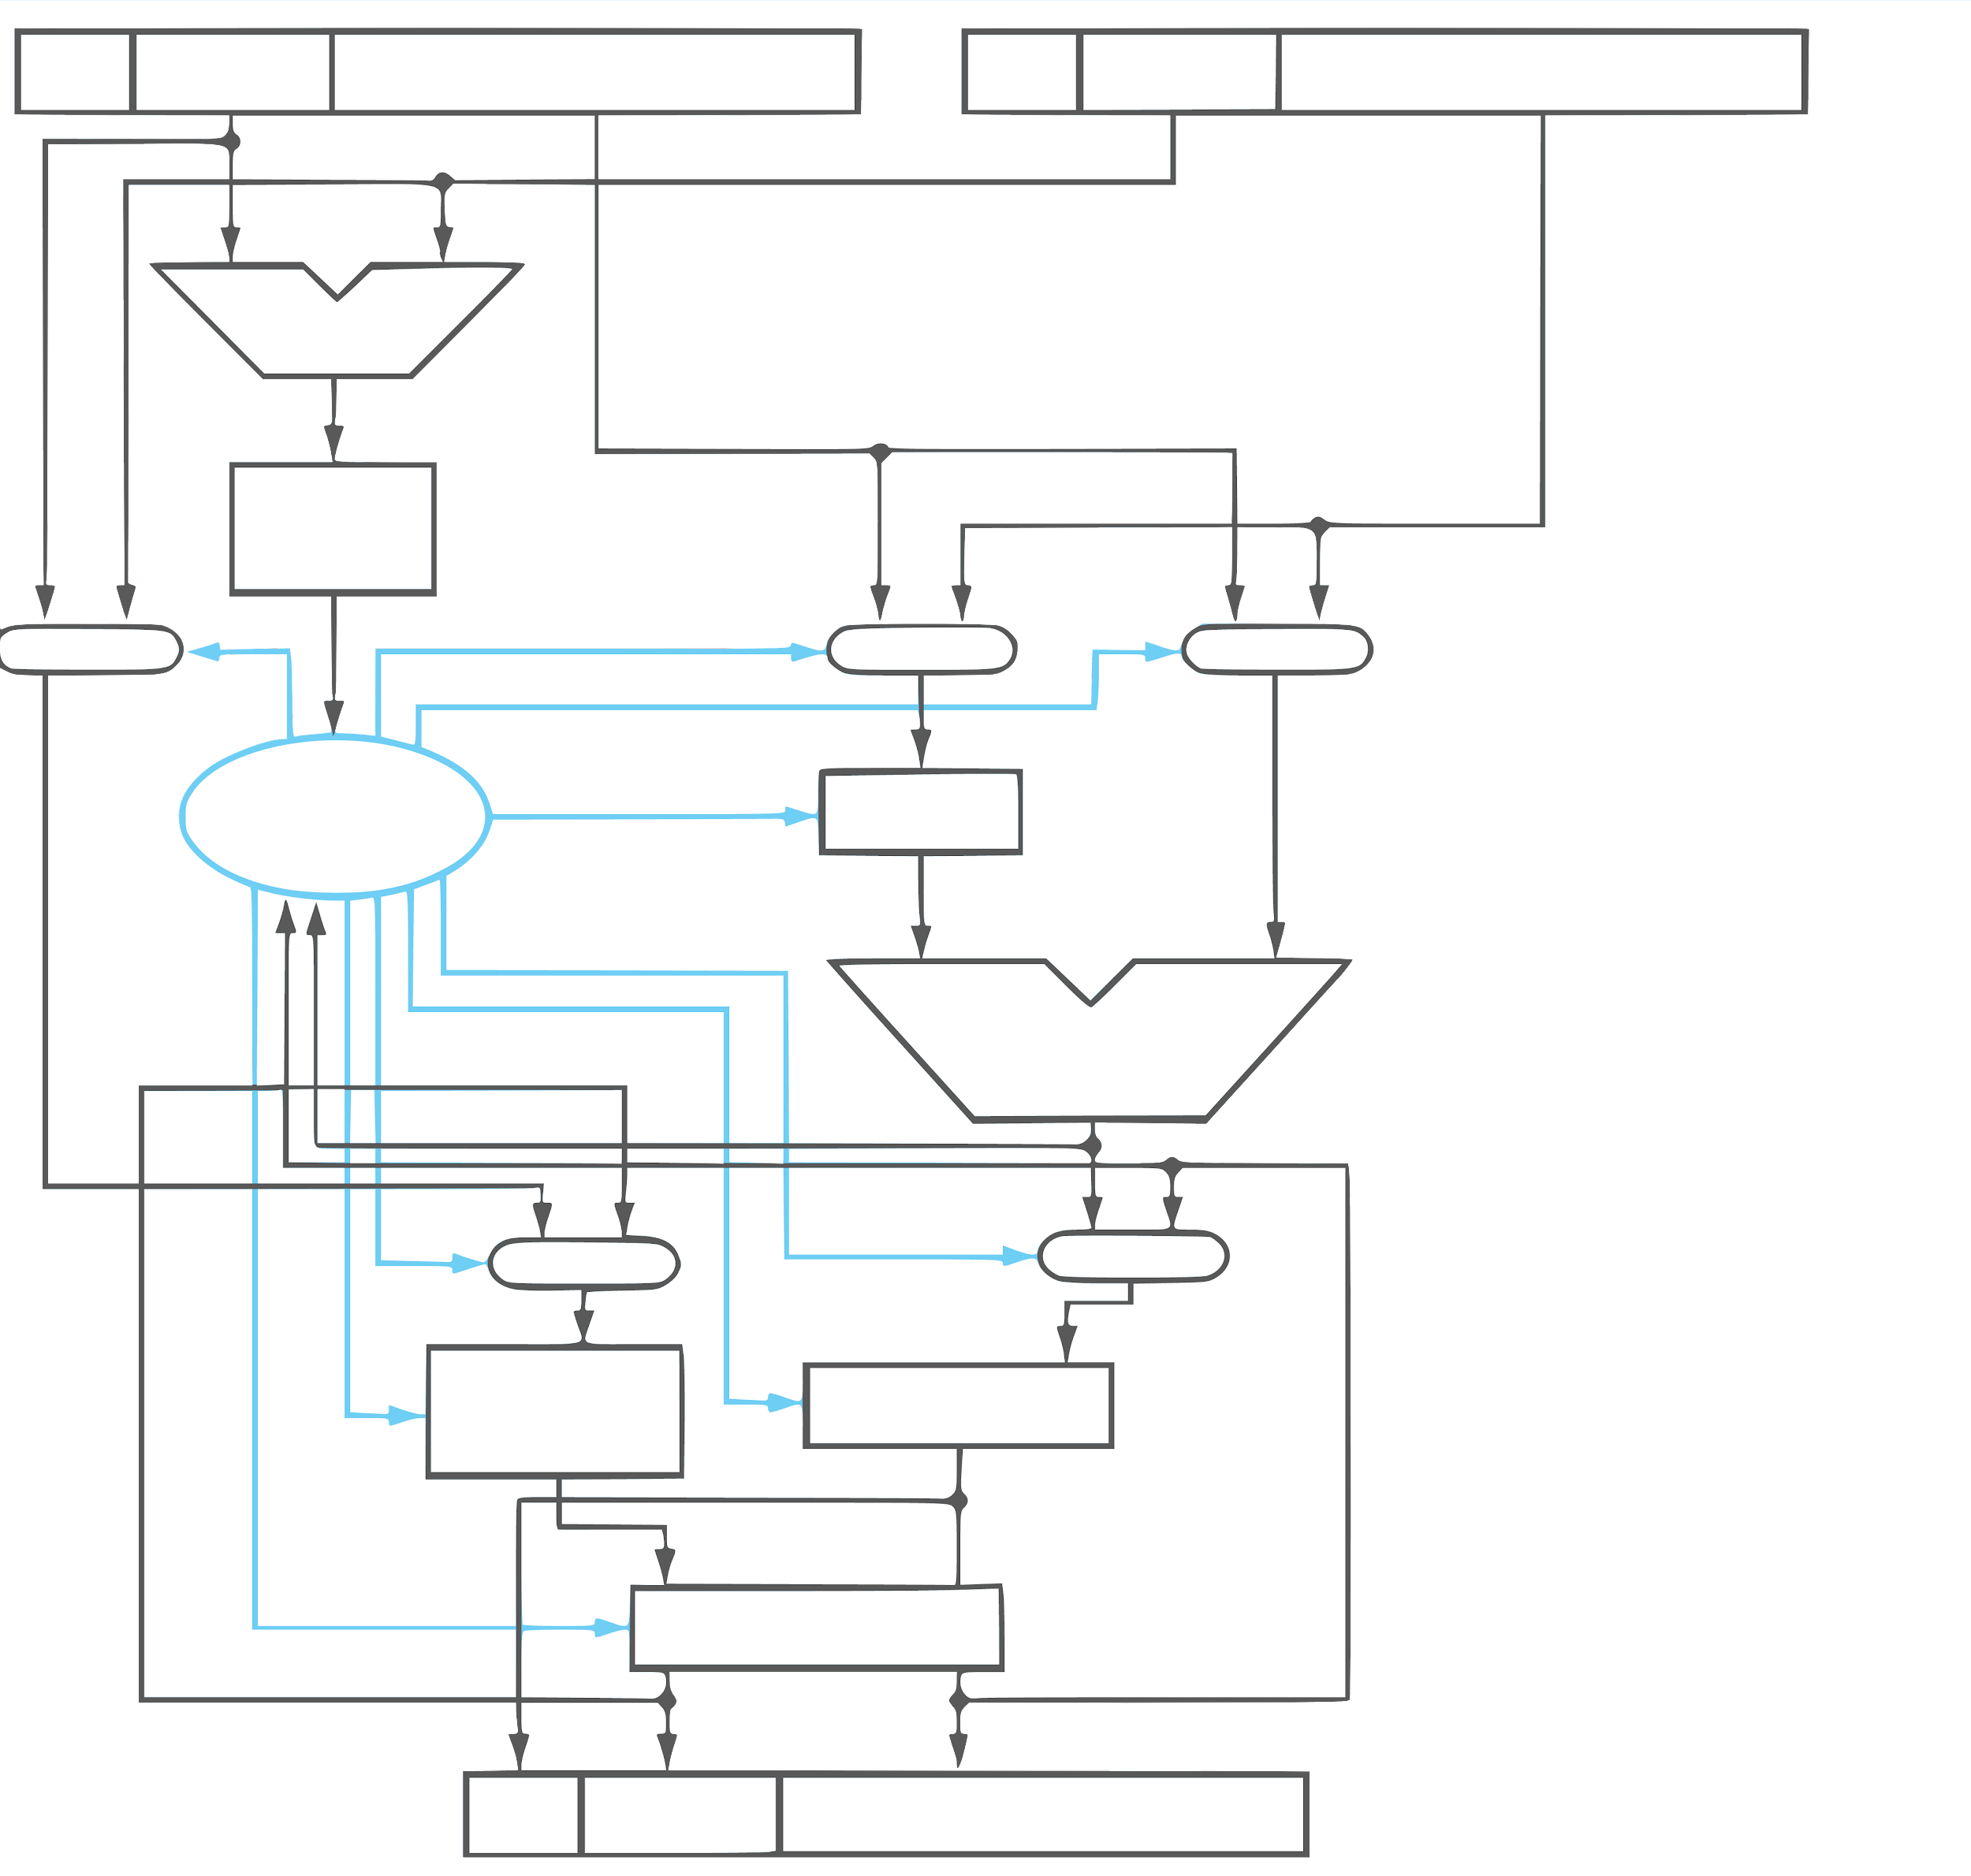
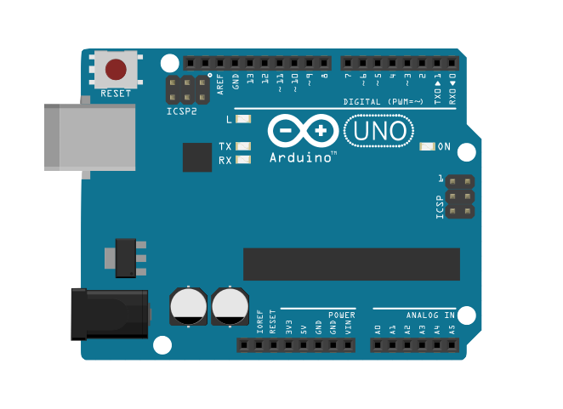
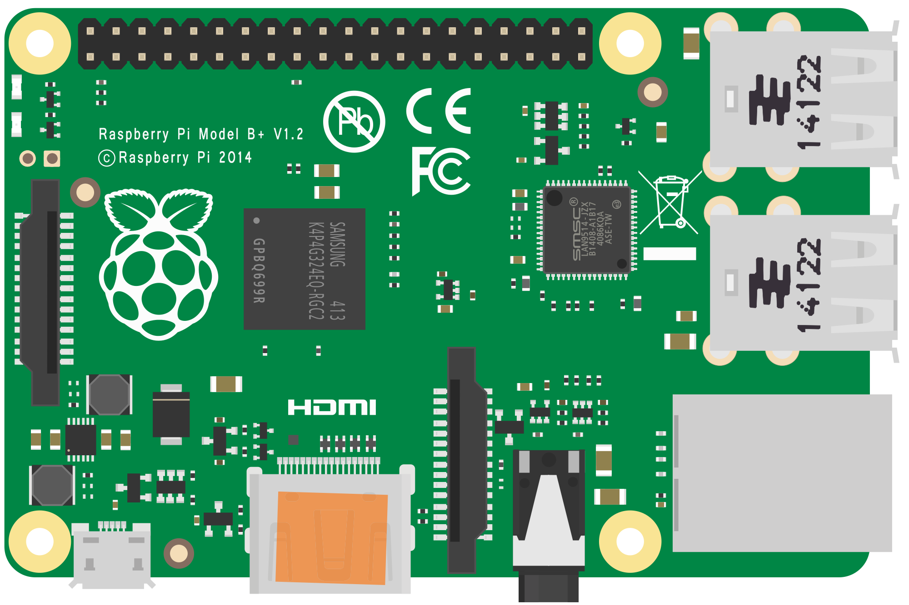
Portability Trade-offs
Single Precision
IEEE 754 Floating-Point Standard
Sign
Exponent
Fraction
Sign
Exponent
Fraction
ALU
Not all embedded systems are created equal. Sacrifice portability across systems for efficiency.
Exponent Difference
0 1
0 1
0 1
Control Unit
>>
ALU
0 1
0 1
++ OR --
>> OR <<
Rounding
Sign
Exponent
Fraction
Lower Code Portability
🅧
🅧
✔
Option 2
Cost ($)
✔
Specific HW Implementation of a Library
Power (W)
✔
Eng. Effort
✔
Notes:
From Ch.1 somewhere…
https://commons.wikimedia.org/wiki/File:Raspberry_Pi_B%2B_illustration.svg
https://commons.wikimedia.org/wiki/File:Arduino_uno.png

Slide 19
How do we Quantize?

Slide 20
Layer 1
Layer 2
Layer 3
a¹
1
w²
a²
w³
a³
1,1
1
1,1
1
a¹
b²
b³
2
w²
1
1
1,2
w³
w²
a²
1,2
a³
2,1
2
2
a¹
b²
b³
3
2
w³
2
w²
2,2
2,3

Slide 21
Weights
Layer 1
Layer 2
Layer 3
a¹
1
w²
a²
w³
a³
1,1
1
1,1
1
a¹
b²
b³
2
w²
1
1
1,2
w³
w²
a²
1,2
a³
2,1
2
2
a¹
b²
b³
3
2
w³
2
w²
2,2
2,3

Slide 22
Weights
Biases
Layer 1
Layer 2
Layer 3
a¹
1
w²
a²
w³
a³
1,1
1
1,1
1
a¹
b²
b³
2
w²
1
1
1,2
w³
w²
a²
1,2
a³
2,1
2
2
a¹
b²
b³
3
2
w³
2
w²
2,2
2,3

Slide 23
Weights
Biases
Activations
Layer 1
Layer 2
Layer 3
a¹
1
w²
a²
w³
a³
1,1
1
1,1
1
a¹
b²
b³
2
w²
1
1
1,2
w³
w²
a²
1,2
a³
2,1
2
2
a¹
b²
b³
3
2
w³
2
w²
2,2
2,3

Slide 24
Weights
Biases
Activations
Layer 1
Layer 2
Layer 3
a¹
1
w²
a²
w³
a³
1,1
1
1,1
1
a¹
b²
b³
2
w²
1
1
1,2
w³
w²
a²
1,2
a³
2,1
2
2
a¹
b²
b³
3
2
w³
2
w²
2,2
2,3

Slide 25
Reduce Precision (Discretize)
Count
Count
Weight Value
Weight Value

Slide 26
-5.4
Original 32-bit float values
0.0
+4.5

Slide 27
-5.4
Original 32-bit float values
0.0
+4.5
0
1
2
3
4
8-bit encoding
251
252
253
254
255
...

Slide 28
-5.4
Original 32-bit float values
0.0
+4.5
0
1
2
3
4
8-bit encoding
251
252
253
254
255
...
-5.4
0.0
+4.5
Reconstructed 32-bit float values

Slide 29
-5.4
Original 32-bit float values
0.0
+4.5
0
1
2
3
4
8-bit encoding
251
252
253
254
255
...
-5.4
0.0
+4.5
Reconstructed 32-bit float values

Slide 30
-5.4
Original 32-bit float values
0.0
+4.5
0
1
2
3
4
8-bit encoding
251
252
253
254
255
...
-5.4
0.0
+4.5
Reconstructed 32-bit float values

Slide 31
-5.4
Original 32-bit float values
0.0
+4.5
0
1
2
3
4
8-bit encoding
251
252
253
254
255
...
-5.4
0.0
+4.5
Reconstructed 32-bit float values

Slide 32
Quantization

Slide 33
Quantization
Post-training Quantization
Quantization-aware Training

Slide 34
Quantization
Post-training Quantization
Quantization-aware Training

Slide 35
Quantization
Post-training Quantization
Quantization-aware Training
Quantized Weight Compression (for size)
Quantized Inference Calculation (for latency)

Slide 36
Quantized Weight Compression (for size)
Quantized Inference Calculation (for latency)
Decompress each weight value from 8-bit integer into a fp32 floating-point value before multiplying it with the input value:
output = … inputn * decompress(q_weightn)
Where:
decompress(quantized_code) {
return float((quantized_code / 255.0) * (max - min)) + min;
}

Slide 37
Quantized Weight Compression (for size)
Quantized Inference Calculation (for latency)
Imagine that we artificially reduce the precision of every input to the dot product, so that they’re no longer using the full range of a 32-bit float:
output = … quantize(inputn, step) * quantize(weightn, step)
Where:
quantize(x, step) {
return round(x*step) / step;
}
e.g., quantize(3.14, 1.0) = 3.0 (rounding to nearest whole number) and quantize(3.14, 0.1) = 3.1 (rounding to nearest 1/10)

Slide 38
What are the trade-offs?

Slide 39
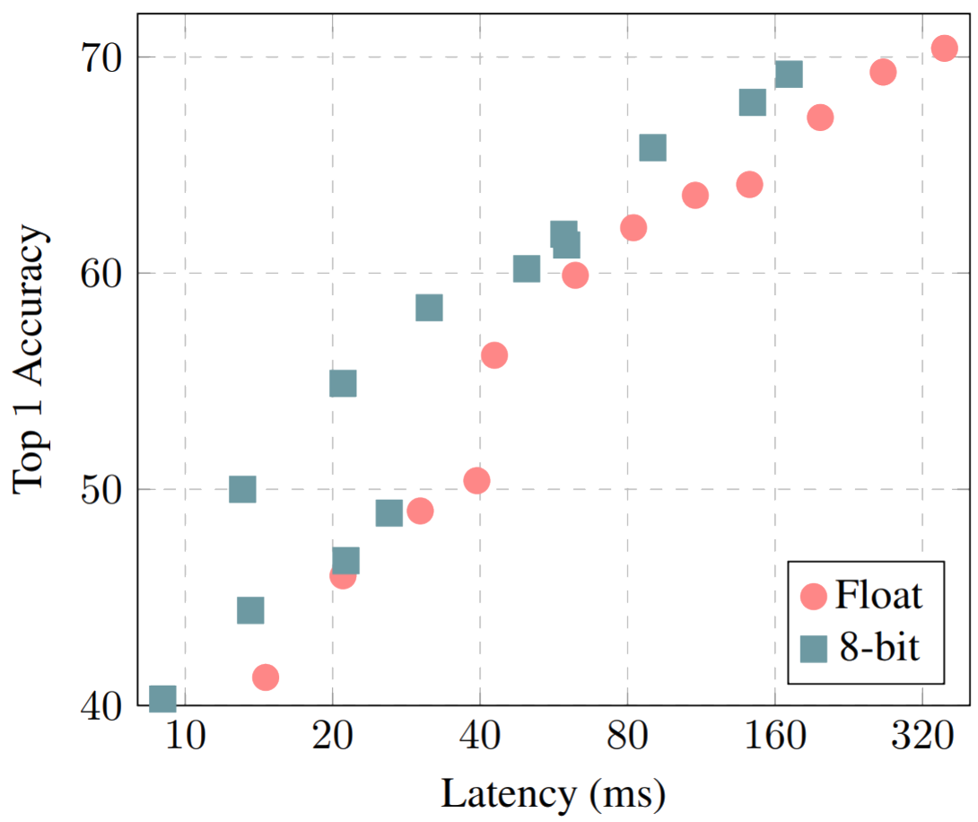
Accuracy-Latency Trade-off
Quantization works well but performance but can suffer from accuracy loss during inference.
Source: “Accuracy-latency tradeoff with MobileNets” Benoit et al.

Slide 40
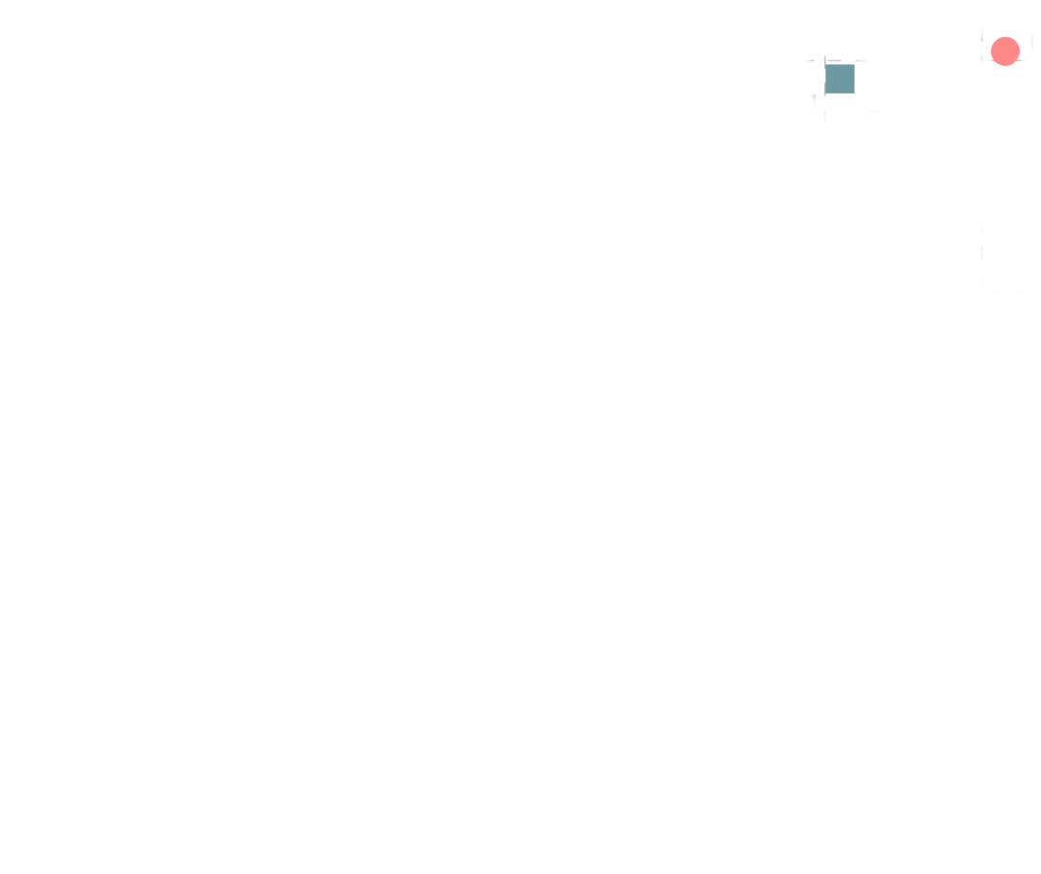
Accuracy-Latency Trade-off
Quantization works well but performance but can suffer from accuracy loss during inference.
Source: “Accuracy-latency tradeoff with MobileNets” Benoit et al.

Slide 41
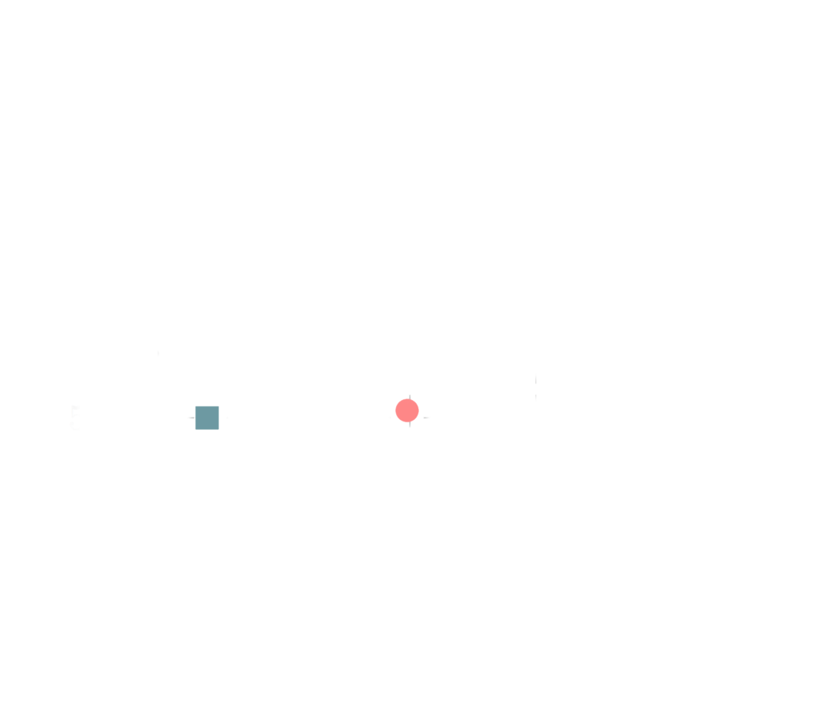
Accuracy-Latency Trade-off
Quantization works well but performance but can suffer from accuracy loss during inference.
Source: “Accuracy-latency tradeoff with MobileNets” Benoit et al.

Slide 42
About Quantizing Other NN Parts?
Weights
Activations
Channels
Tensors
Layers
...
Every network has something unique for it, so the degree to which you can quantize (e.g., weights, activations) will vary.

Slide 43
About Quantizing Other NN Parts?
Layer 1
Layer 2
Layer 3
Weights
Activations
Channels
Tensors
Layers
...
a¹
1
w²
a²
w³
a³
1,1
1
1,1
1
a¹
b²
b³
2
w²
1
1
1,2
w³
w²
a²
1,2
a³
2,1
2
2
a¹
b²
b³
3
2
w³
2
w²
2,2
2,3

Slide 44
In Summary…

Slide 45
Summary
Doing all calculations in eight-bit integers offers some compelling advantages:
Faster arithmetic. You need a lot fewer gates to implement an eight-bit integer multiply-add than a 32-bit floating point operation.

Slide 46
Summary
Doing all calculations in eight-bit integers offers some compelling advantages:
Faster arithmetic. You need a lot fewer gates to implement an eight-bit integer multiply-add than a 32-bit floating point operation.
Lower memory demands. We’re only accessing eight bits instead of thirty-two, which reduces the load on the memory system by 75%.

Slide 47
Summary
Doing all calculations in eight-bit integers offers some compelling advantages:
Faster arithmetic. You need a lot fewer gates to implement an eight-bit integer multiply-add than a 32-bit floating point operation.
Lower memory demands. We’re only accessing eight bits instead of thirty-two, which reduces the load on the memory system by 75%.
Reduced resource requirements. Many low-end microcontrollers and DSPs lack floating-point hardware, so avoiding floats increases portability.

